Slide 1


The Chilly Dog Group Members Grant Franklin Martin Rennaker Yarentzy Magallanes Sponsor Skyelar Head TA Sambandh Dhal

Slide 2
Project Overview
Problem statement
A car parked outside on a sunny, 95-degree day can reach temperatures of up to 117 degrees Fahrenheit in just 30 minutes.
Approximately 100 dogs die in vehicles from heat exhaustion according to the AVMA.
Solution
Provide ideal cabin conditions to allow your pet to safely stay unattended in a vehicle.
Notes:
***You stop at the store just to run in for a second, and leave your pet in the car with the windows “cracked.” You’re just going to grab a couple of things, so it should all be fine. However, the lines in the store are long, you found a few extra things you needed Your pet should still be okay, though… he’s only been out there for about 20-30 minutes. Right?
Wrong.
***A car parked outside on a sunny, 95-degree Fahrenheit day can reach temperatures of up to 117 degrees Fahrenheit in just 30 minutes.
Your quick trip to the grocery store could be the determining factor between your pets life or death.
**approximatley 100 dogs die from heat exhaustion according to the American Veterinary Medical Association.
***We, the chilly dogs, have created a device to keep your cabin cool while you are away and assure the safety of your pet.
***The chilly dog is a battery powered car A/C system. that can cool the inside of your vehicle without relying on the motor of your car or its battery.
***Chilly Dog users will be able to adjust the desired output temperature using a phone application and even recive alerts when conditions become unfit for the pet.

Slide 3
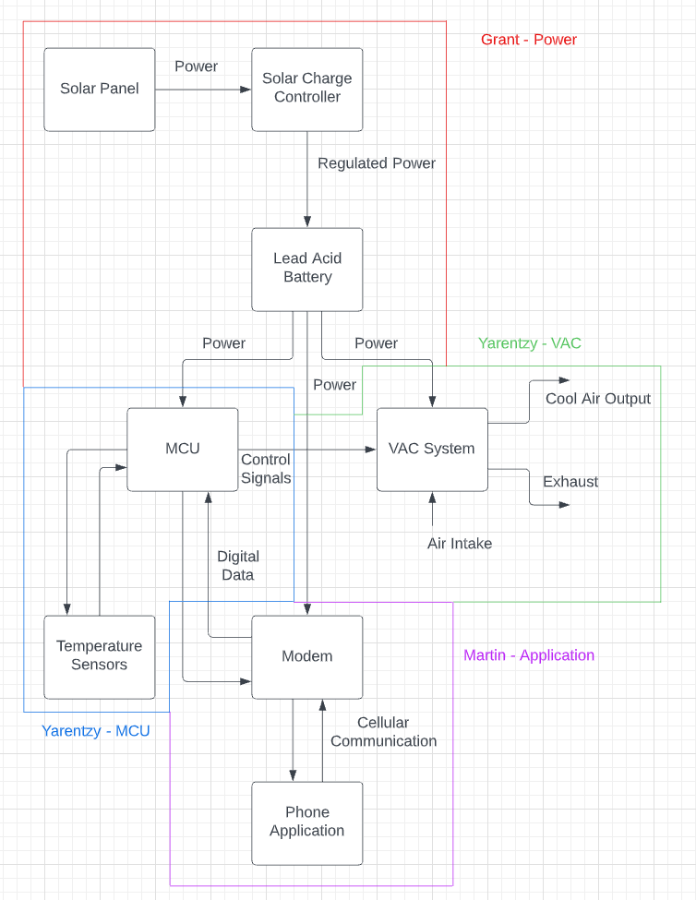
Subsystem Block Diagram

Slide 4
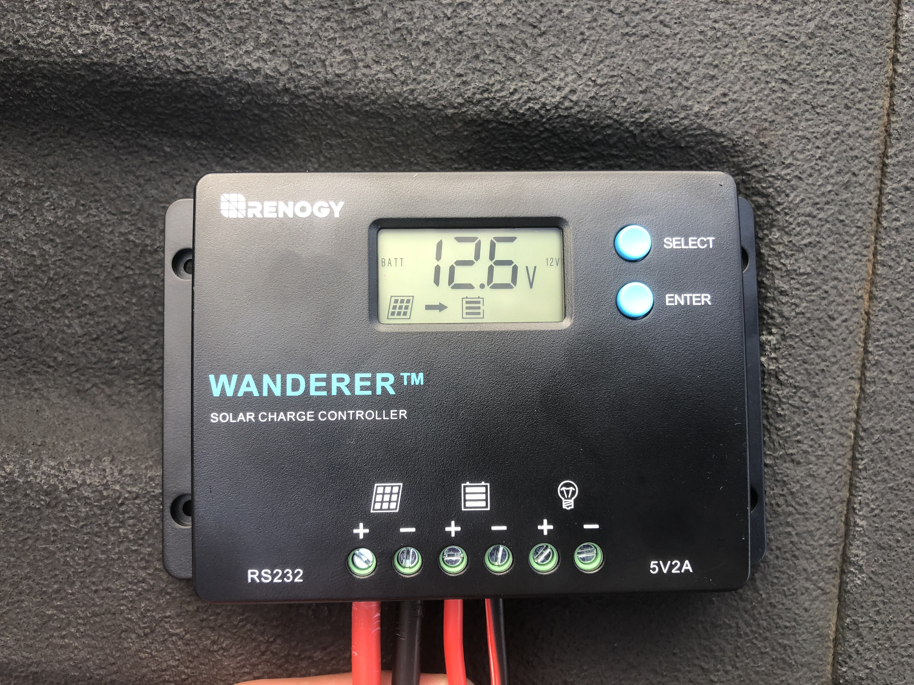
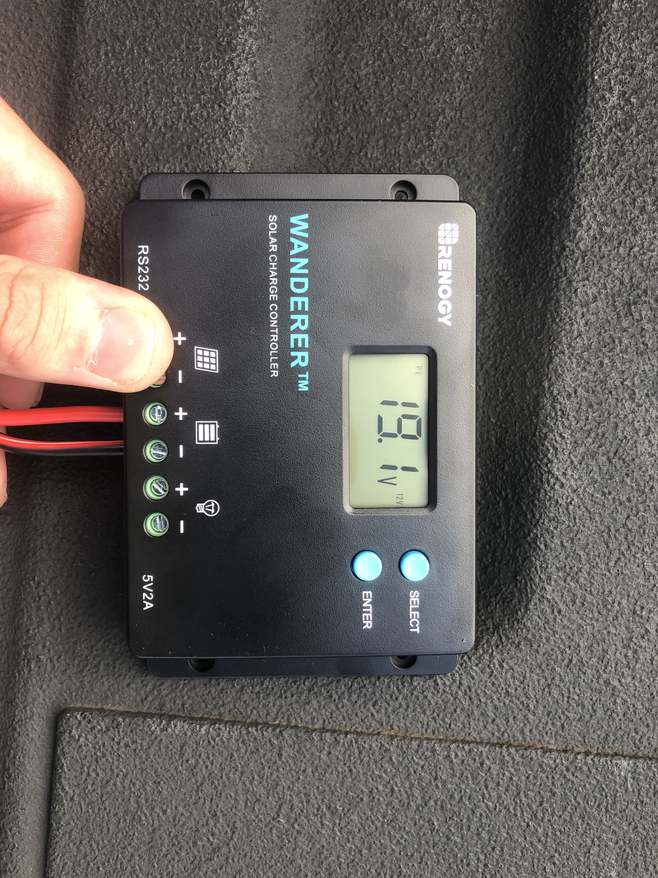
Power Supply Accomplishments
Ensured that the battery can be charged by solar panel with charge controller
Showed that the battery can power the VAC system using an inverter
Solar Panel charging battery
Solar Panel output voltage

Slide 5
Power Supply Accomplishments
Line/Load regulation tests on breadboard
Load Regulation Data
Line Regulation Data

Slide 6
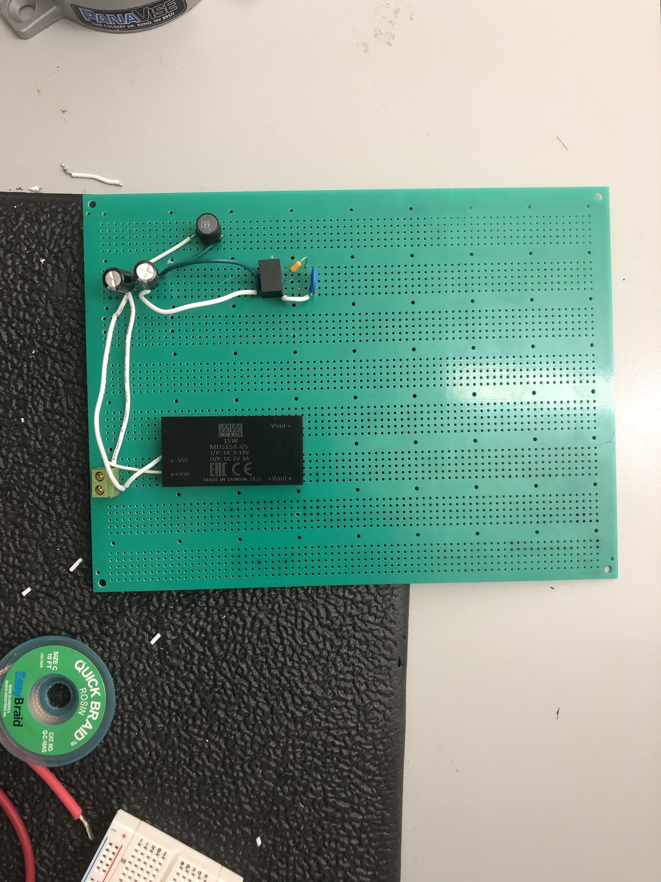
Remaining Tasks for Demo
Power Supply
Load/Line regulation tests on Perfboard
Conduct battery-Perfboard and battery-VAC tests

Slide 7
Remaining Tasks for 404
Create circuits to show battery life and step-down current from car outlet to relay
Finish design and testing of PCB
Test switching input circuit
Ensure that actual loads can function with power supply

Slide 8
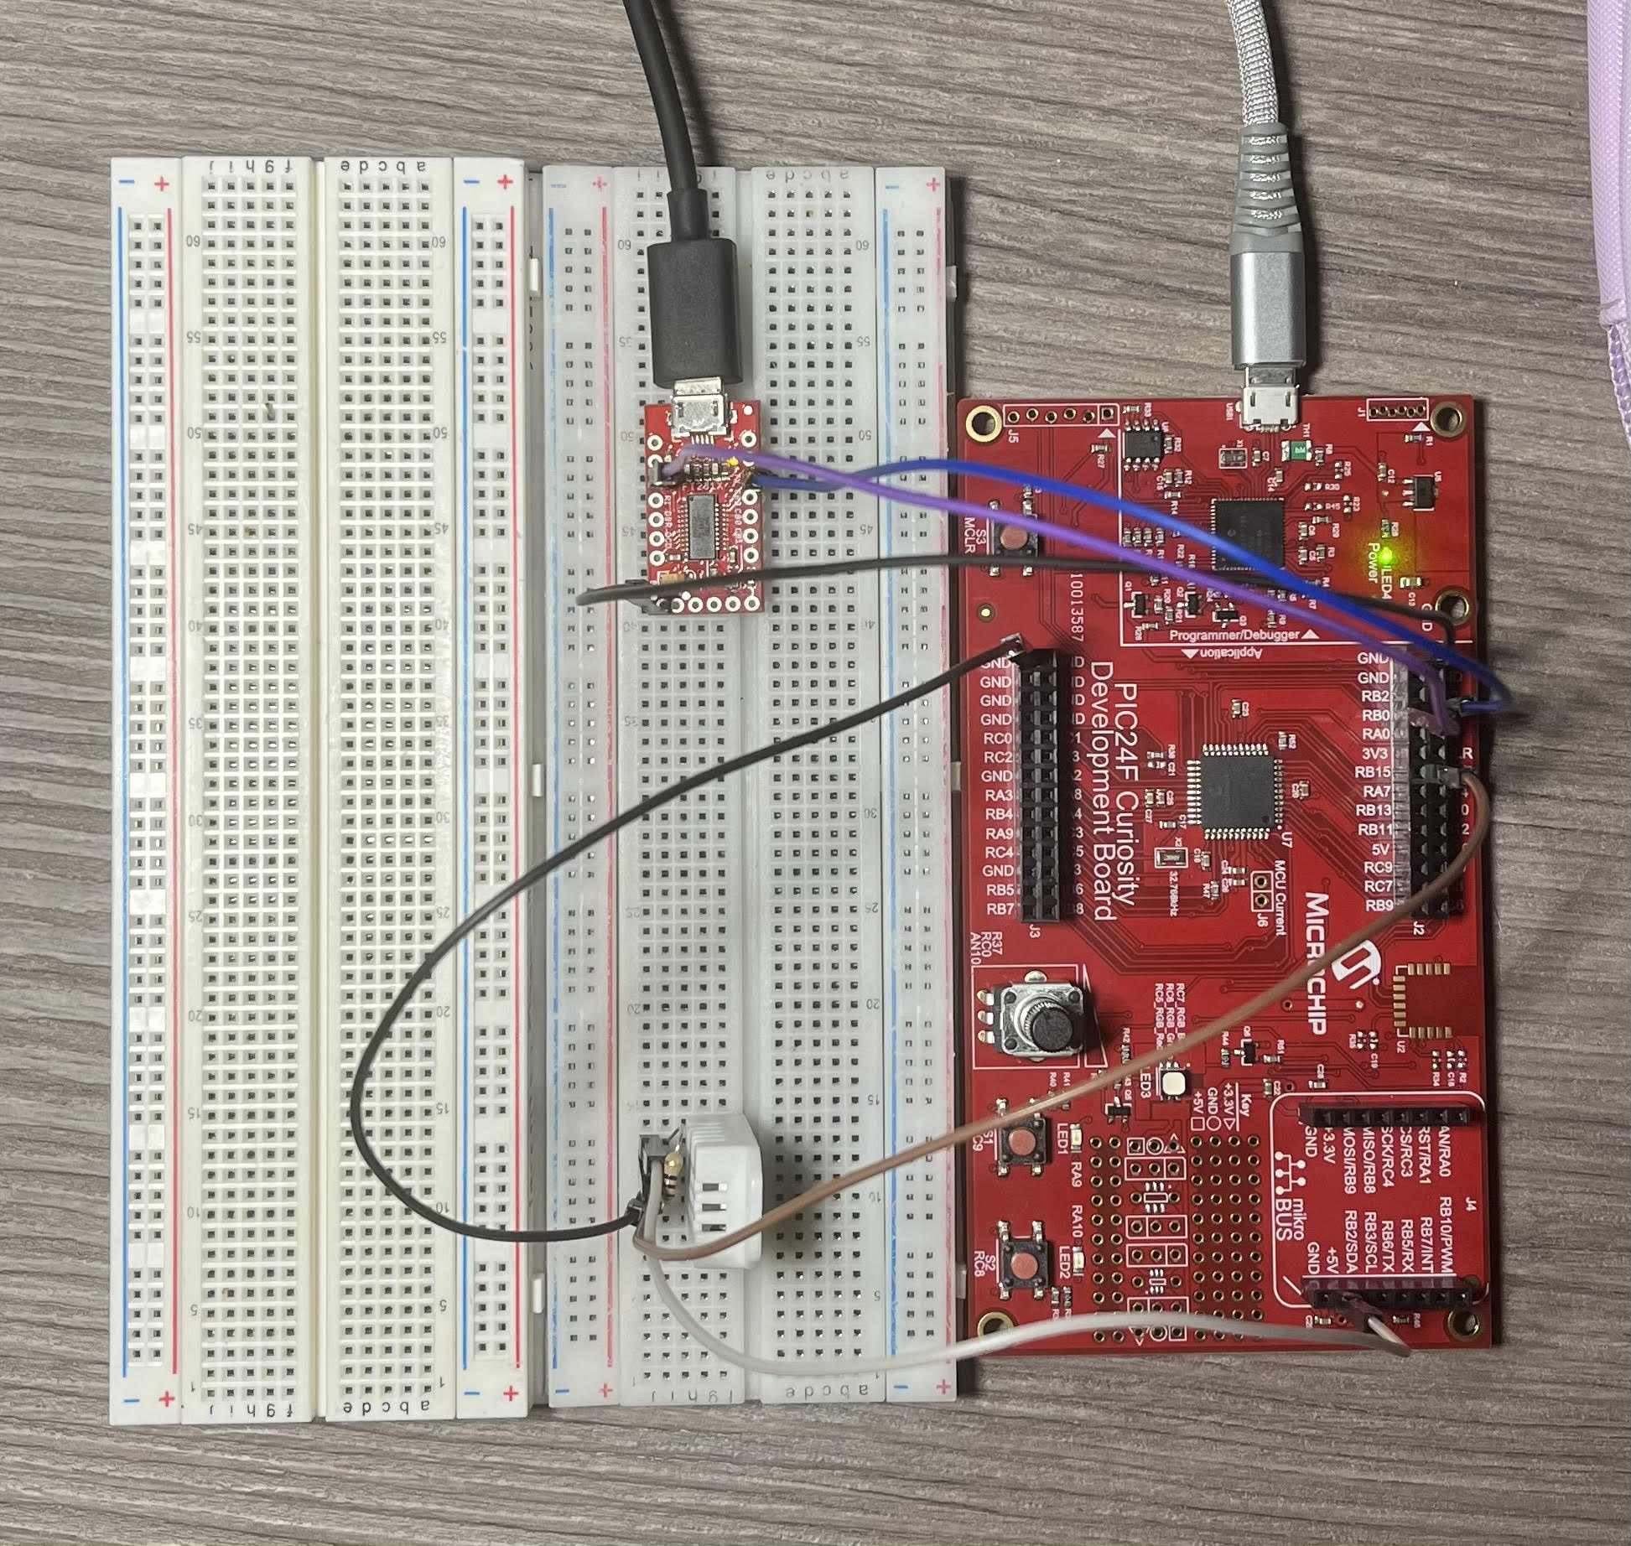
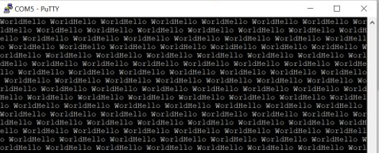
MCU Accomplishments
System configuration
I/O Configuration and control
Timer using polling
Timer using Interrupts
Delays
UART Serial Communication
Redirect Printf
Variable strings
Temperature
Notes:
The things I accomplished include configuring the system as well as the I/O pins. I wanted to take a deeper look into what the MCC is actually doing and build a strong foundation to be able to debug more efficiently. I sucessfully created projects with timers using polling and timers using interrupts as well as hand coding delays. I have established UART serial communication betweeen my pic and my PC using putty and have usefully redirected the printf() function again for debugging.

Slide 9
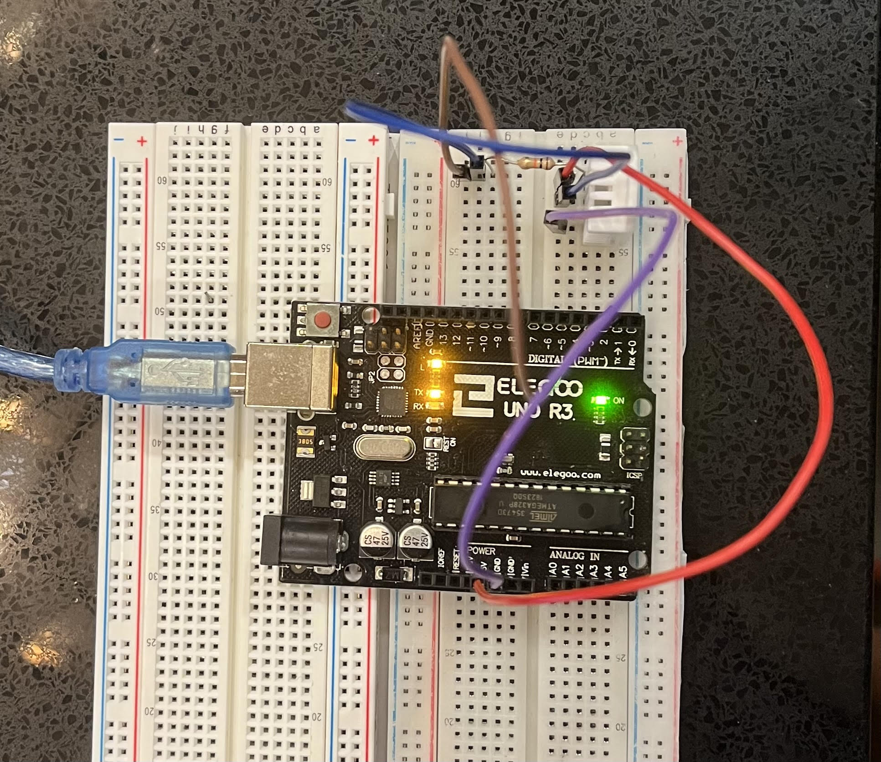
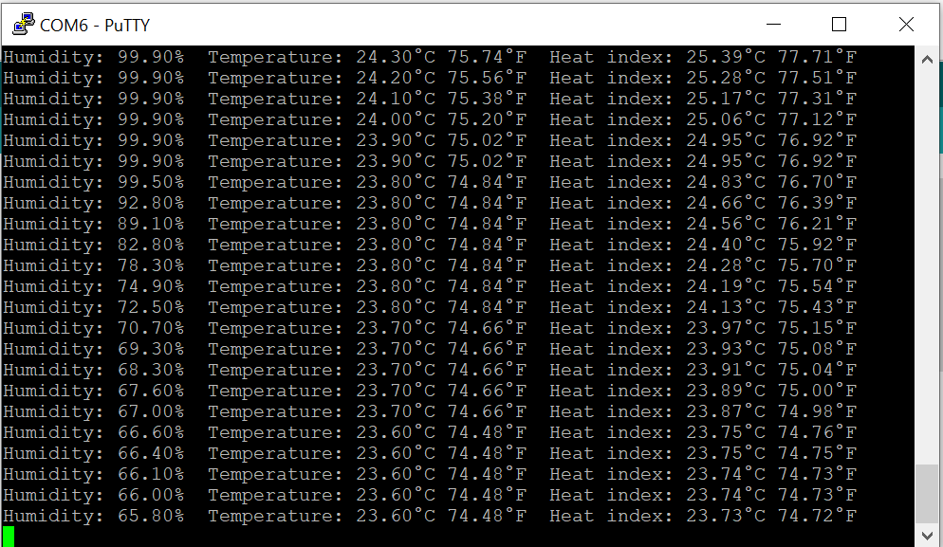
MCU Accomplishments
Temperature
Verified functionality using Arduino
Notes:
A huge part of my subsytem that is in the works of being implemented is reading temperature data. I have tested and verified the functionality of my temperature sensor through an arduino and its corresponding library. My steps forward will be discussed in the next slide.

Slide 10
Remaining Tasks for Demo
Translate Arduino code to MPLabX
Receive first reading using the PIC and validate
Accept UART input from PC
Perf Board for DEMO
Notes:
After assuring my sensor had full functionality. I will be able to go into the code and translate it from Arduino to PIC and outputting that to the uart terminal. From there I will work on reciving input from the PC to turn on an LED which will later translate to turning on the VAC System. And finally putting everything into conrete on a perf board for demo

Slide 11
Remaining Tasks for 404
Establish UART communication with Martins Modem
Determine method of configuring VAC settings
Fabrication and assembly of final PCB
3D printing the exhaust tube
Notes:
Tasks for 404 include switch over that already established uart communication from my pic to pc to pic to pic and interfacing with matrins modem. Determining the method of controlling the VAC which as of now looks like mechanically pressing the buttons on the remote, fabbricating the Final PCB and to put the cherry on top, 3D printing the exhaust Tube.

Slide 12
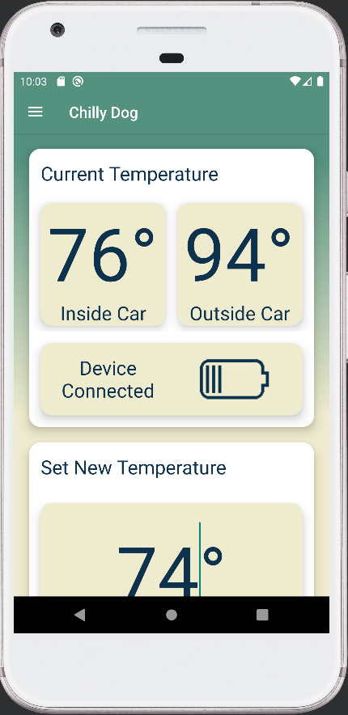
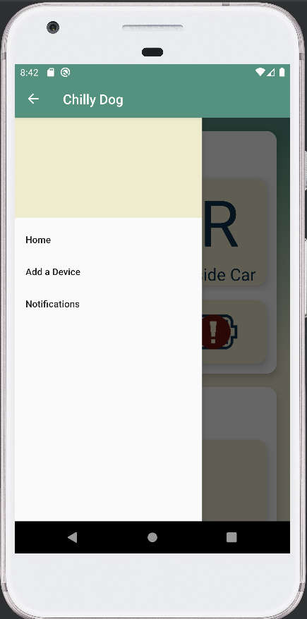
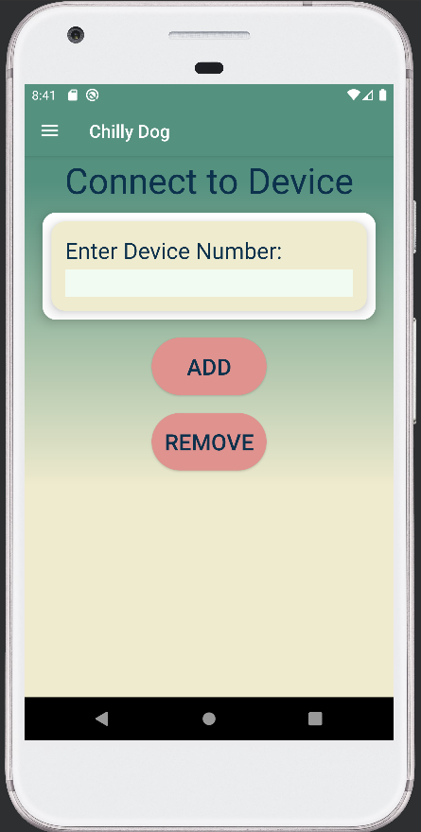
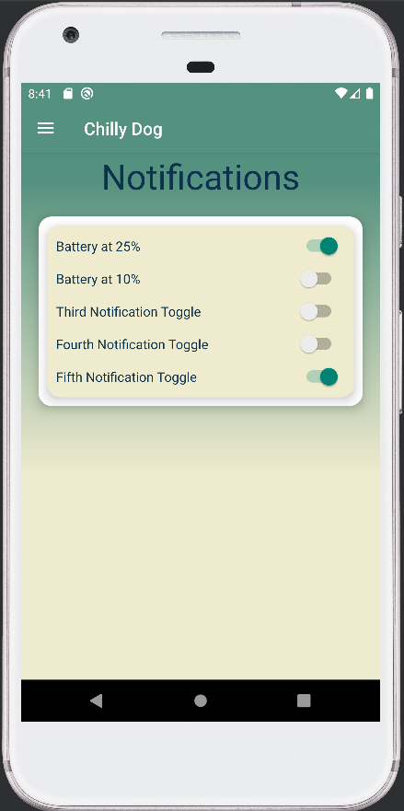
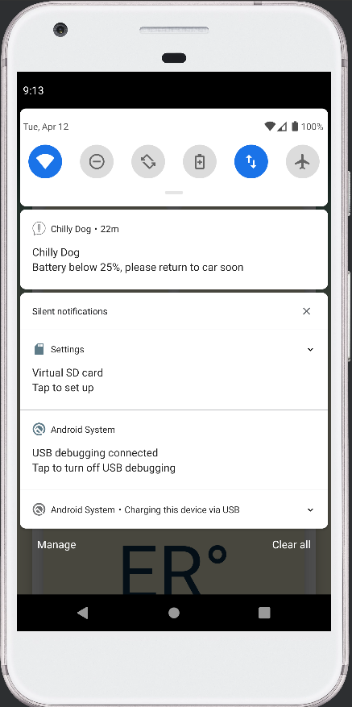
Phone App Accomplishments
Done in 403
Takes input via text and displays it to UI
Can pair and unpair device and when paired communicates with device to retrieve current data
Takes user input for temp and sends it to device
Can toggle different notifications on and off and will send notifications when app is in the background
Right – App Layout
Left – Notification made by app when sent under 25% battery life

Slide 13
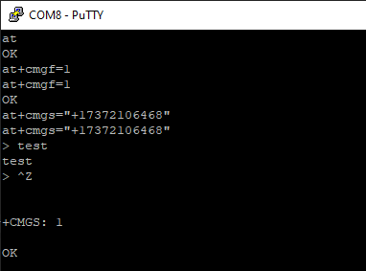
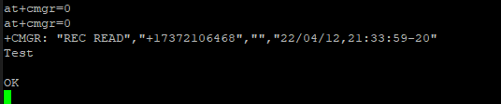
Modem Accomplishments
Done in 403
Using AT commands sent and received text messages
Opened a serial port and sent the AT commands through that
Wrote a program to send and receive text messages using python and the AT commands
Receive data via UART on Pi
Remaining tasks for demo
Finalizing the AT command program
Send data to raspberry pi pins
Up – Sending a text with AT commands
Down - Receiving a text with AT commands

Slide 14
Remaining Tasks for 404
Removing the Pi from the system
Interfacing that with the main system
Deciding the specific notifications the app should send to the user
Improving the UI of the app

Slide 15

Validation

Slide 16
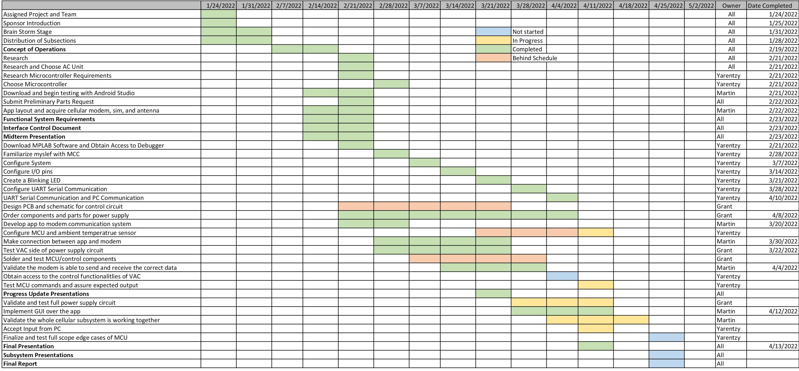
Execution

Slide 17

Questions?

